Slide 1
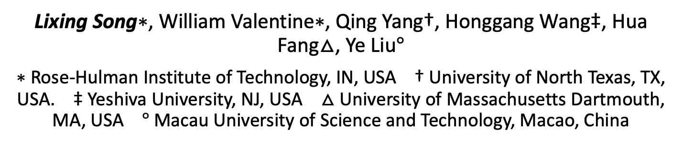
BB-Align: A Lightweight Pose Recovery Framework for Vehicle-to-Vehicle Cooperative Perception
Lixing Song∗, William Valentine∗, Qing Yang†, Honggang Wang‡, Hua Fang$△$, Ye Liu$°$
∗ Rose-Hulman Institute of Technology, IN, USA † University of North Texas, TX, USA. ‡ Yeshiva University, NJ, USA $△$University of Massachusetts Dartmouth, MA, USA $°$Macau University of Science and Technology, Macao, China
Notes:
Welcome to my talk..
My name is Lixing
It is my great pleasure to present my work, titled
This work is collaborated with AT&T labs and my alma mater

Slide 2
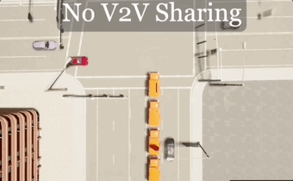
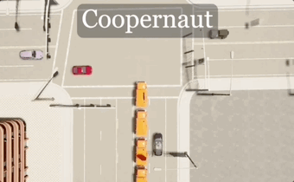
Background & Motivation
Traditional autonomous driving systems can be limited by the inherent constraints of single-vehicle perception systems, such as:
Short range
Occlusions (blocking of the line of sight)
By integrating distributed computing into autonomous driving, cooperative perception offers a viable solution to address these limitations
*Credit to Coopernaut (CVPR 2022)

Slide 3
Background & Motivation (cnt.)
Cooperative Perception Fusion Mechanisms
Notes:
Be really brief, like funny brief

Slide 4
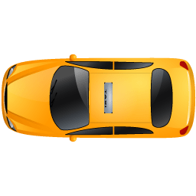
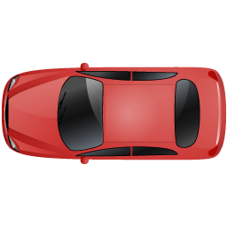
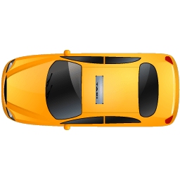




Background & Motivation (cnt.)
Fusing shared data from other vehicle(s) requires accurate pose information (location, orientation) to adjust point of view(s).
Ego Car’s View
$$y$$
Other Car’s View
$$y$$
(0, 0)
(-5, 0)
(5, 0)
(0, 0)
$$x$$
$$x$$
Fused View from Ego Car
Notes:
To further understand the existing methods and their problems, we categorize them into two groups based on the target metrics they tries to measure.
What AT tries to measure is the maximum throughput it can achieve by injecting as much as data traffic.
As you can see, due to its aggressiveness, though relatively accurate, AT tests can be very expensive in terms of both time and data cost. For example, the speedtest usually costs tens or even hundreds megabytes of data and takes more than 10 seconds to run one test.
Another metric is AB that measures….
As AB tests requires minimal inference to existing traffic, AB techniques tends to be quick and light. However, it becomes particularly problematic under modern LTE, due to different packet transmission pattern.

Slide 5
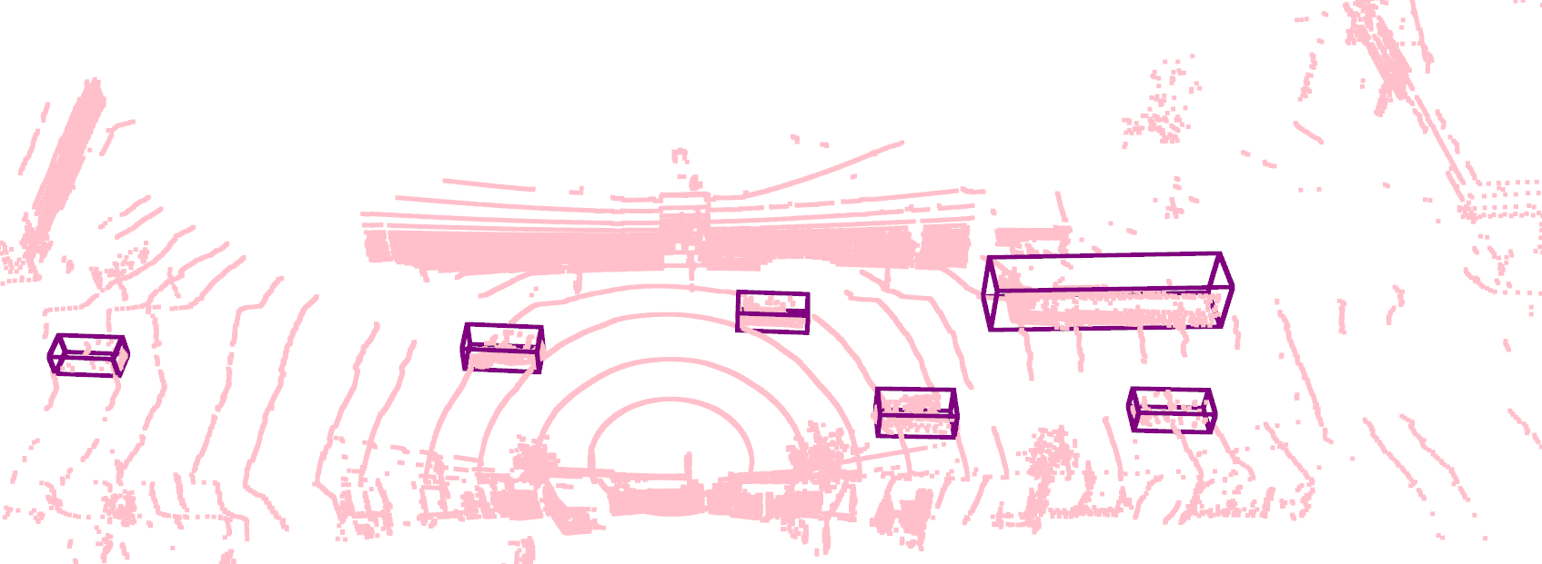
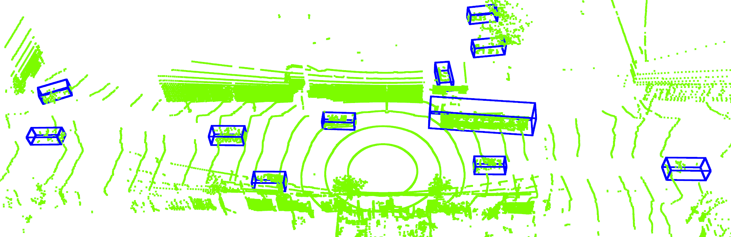
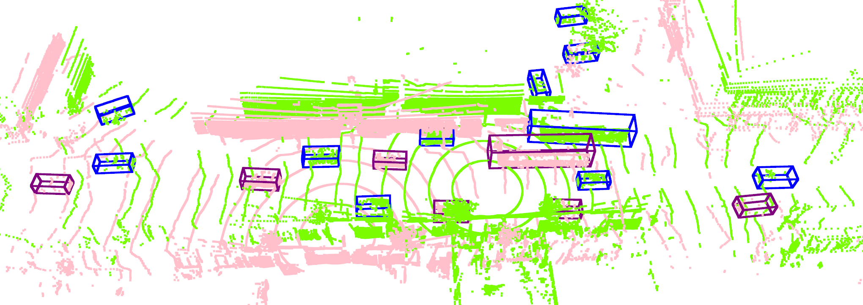
Background & Motivation (cnt.)
Fusing with corrupted pose information can lead to false detection thus hampering driving policy
Ego car’s view
Other car’s view
When fusing the lidar data using inaccurate pose
Notes:
To further understand the existing methods and their problems, we categorize them into two groups based on the target metrics they tries to measure.
What AT tries to measure is the maximum throughput it can achieve by injecting as much as data traffic.
As you can see, due to its aggressiveness, though relatively accurate, AT tests can be very expensive in terms of both time and data cost. For example, the speedtest usually costs tens or even hundreds megabytes of data and takes more than 10 seconds to run one test.
Another metric is AB that measures….
As AB tests requires minimal inference to existing traffic, AB techniques tends to be quick and light. However, it becomes particularly problematic under modern LTE, due to different packet transmission pattern.

Slide 6
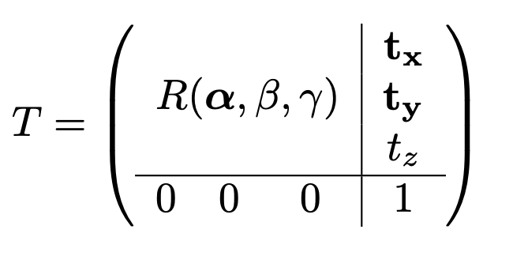
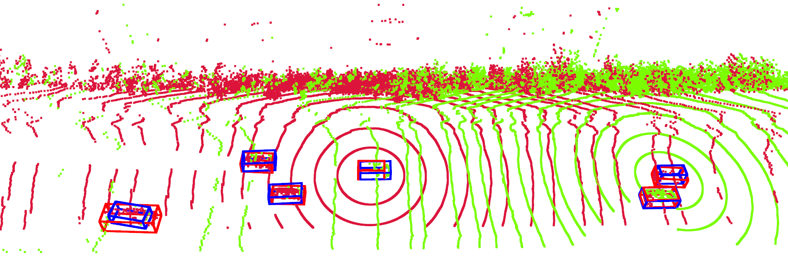
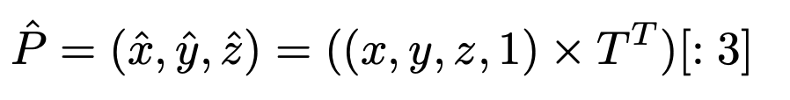
Objective
Input: Two sets of Lidar point clouds captured from two vehicles
Output: Relative pose, transformation matrix, between the two vehicles, i.e., distance and orientation
Cost: Minimal amount of data shared/transmitted between two vehicles
For Ground Vehicles
destination
source

Slide 7
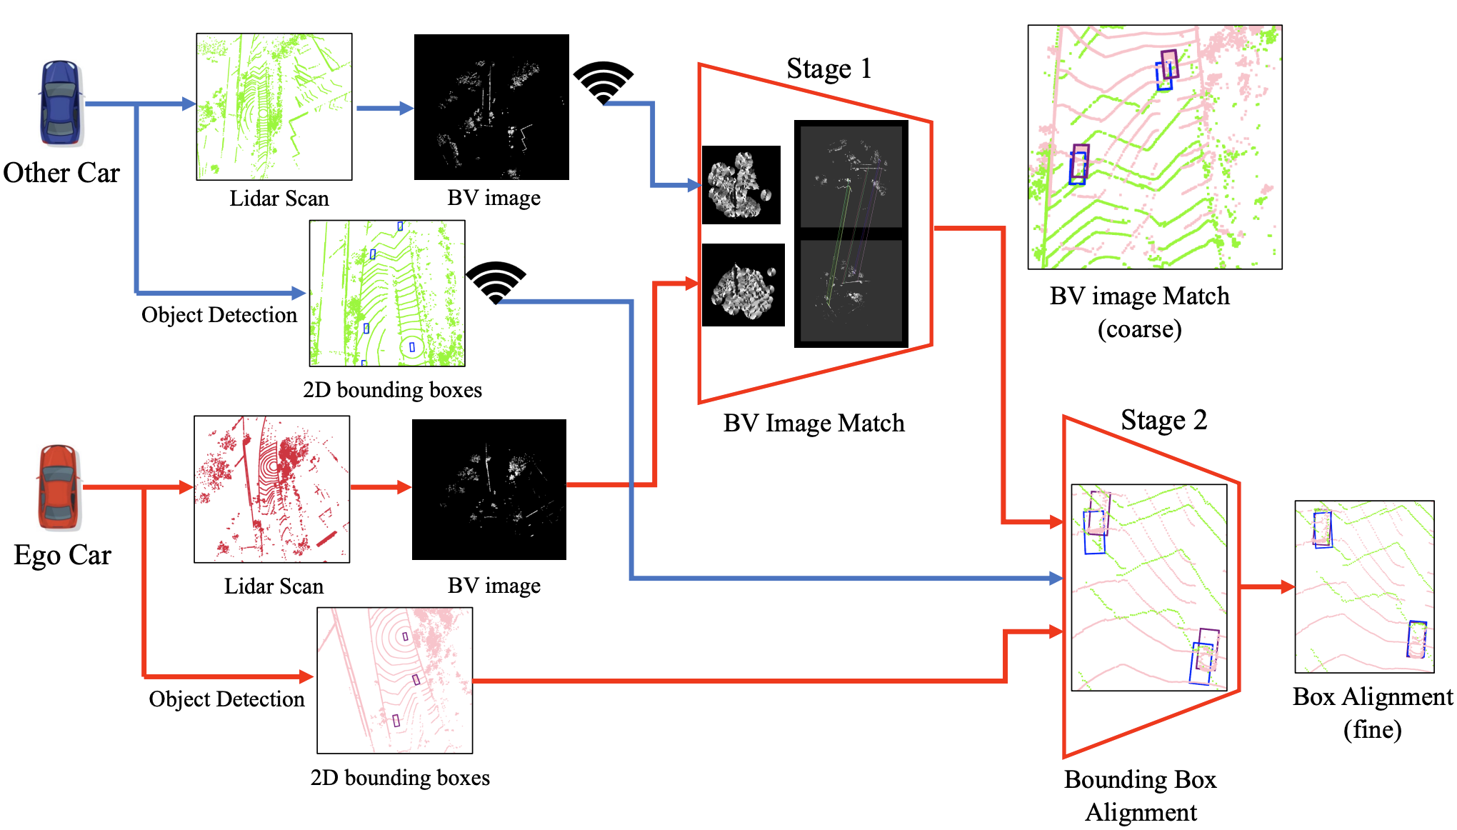
Proposed Method (BB-Align)
A two-staged design:
1) Lidar Bird’s-eye View (BV) images match
2) Object Bounding Boxes alignment

Slide 8
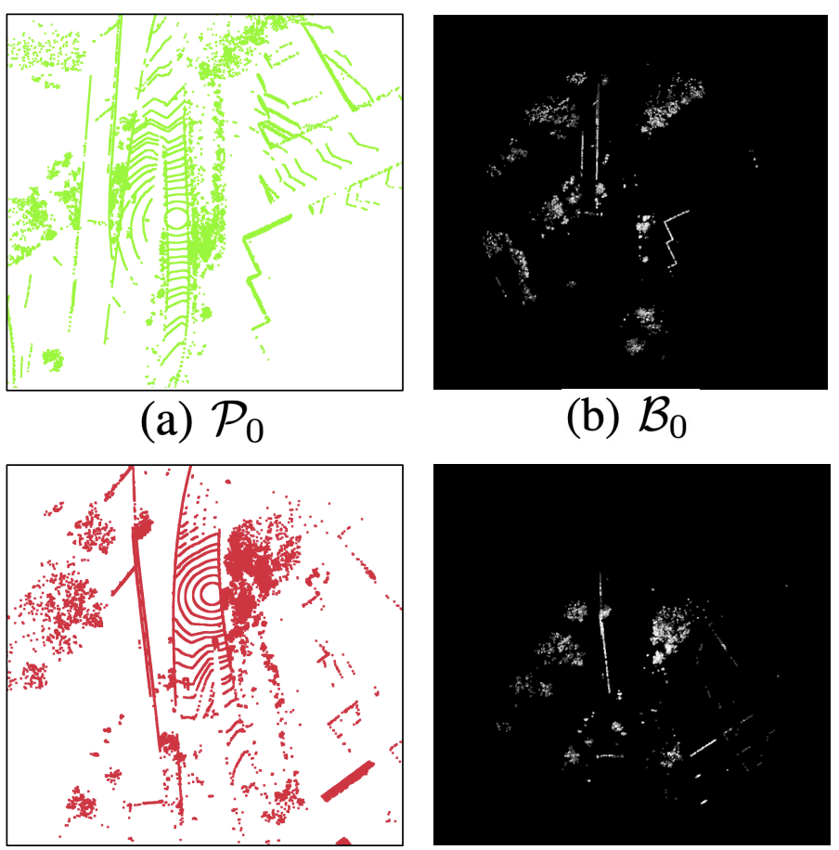
Stage 1: BV Image Matching
Given Lidar point cloud, generate a BV image as a height map
Apply image matching techniques to find relative pose between two BV images
Detecting keypoints (corners, edges)
Computing descriptors using surrounding pixels for each keypoint
Use paired keypoints to calculate transformation
However, the extreme sparsity of Lidar BV images poses significant challenges, particularly in computing effective descriptors.

Slide 9
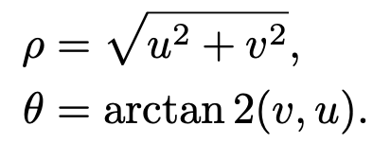
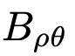
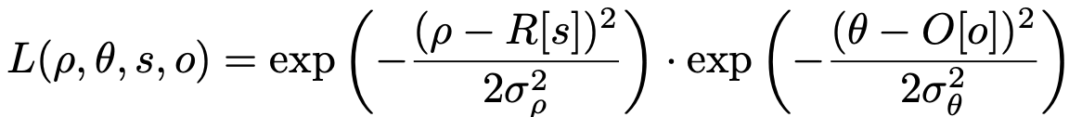
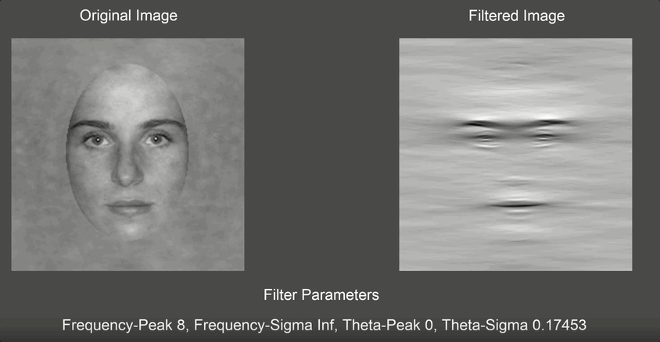
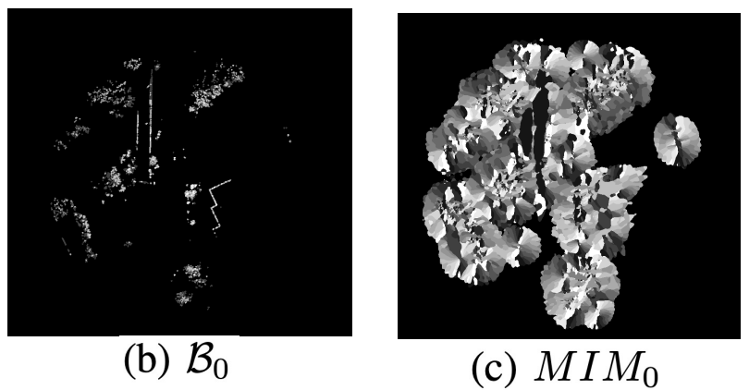
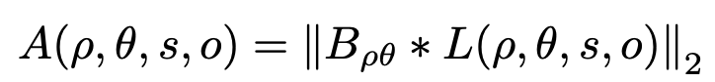
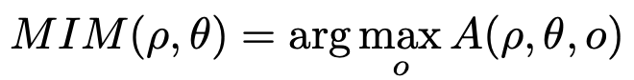
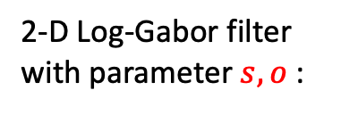
Stage 1: BV Image Matching (cnt.)
Log-Gabor filter-based representation
2-D Log-Gabor filter
with parameter $s, o$ :
Pass through a bank of filters :
Generate Maximum Index Map (MIM):
Credit to https://peterscarfe.com/logGaborFilter.html

Slide 10
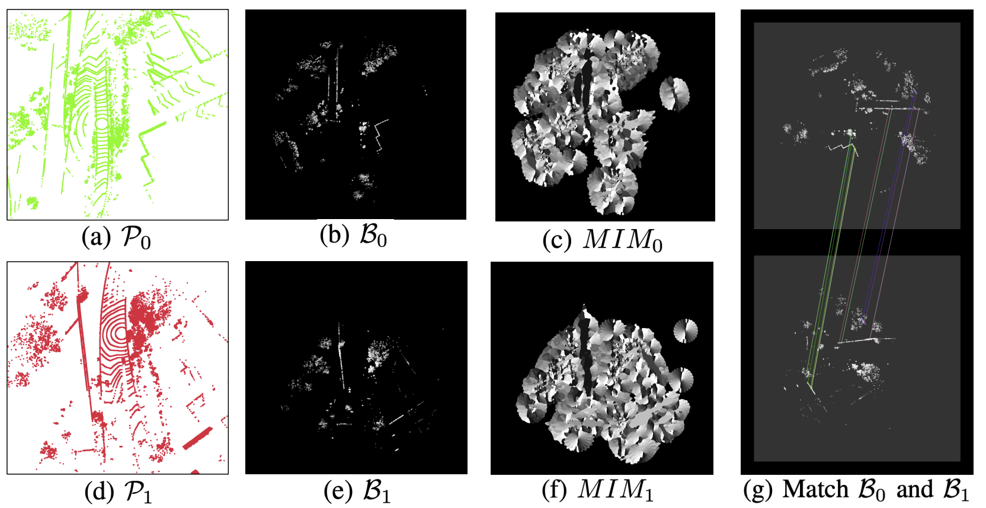
Stage 1: BV Image Matching (cnt.)
Given the feature map MIM, we can computer Bird’s-eye View Feature Transform (BVFT) descriptors [1] for all keypoints (similar to SIFT).
With the paired keypoints in pairs, we employ the RANdom SAmple Consensus (RANSAC) algorithm to estimate the relative pose between the two images.
[1] L. Luo, S. Cao, B. Han, H.-L. Shen, and J. Li, “Bvmatch: Lidar-based place recognition using bird’s-eye view images,” IEEE Robotics and Automation Letters, 2021.

Slide 11
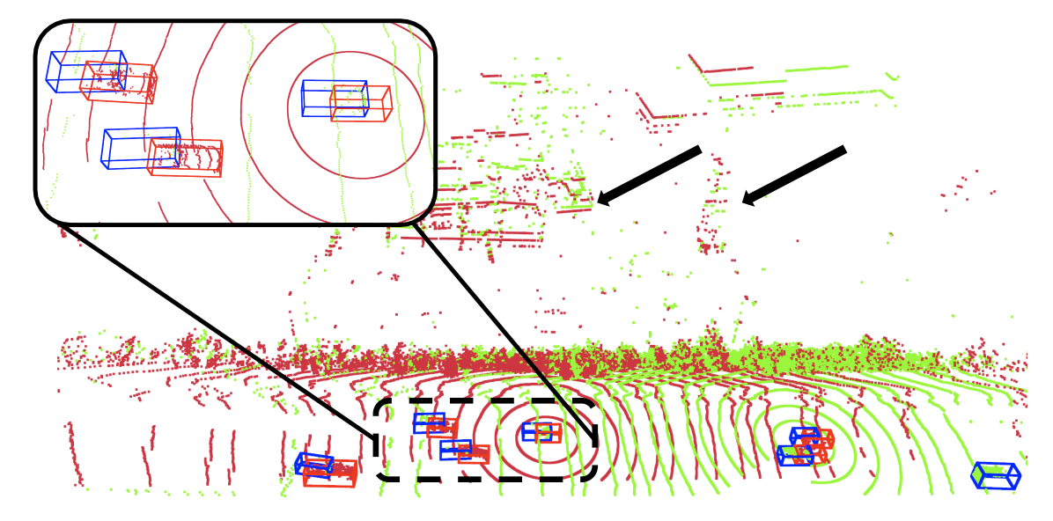
Stage 2: Motivation
LiDAR self-motion distortion: When the car is moving, each point is not measured at the same location, thus causing distortion.
Large static landmarks (buildings, trees) are aligned, but the moving objects (vehicles) are not.
The 3-D bounding boxes, indicated in blue and red, highlight objects (cars) detected by different cars.

Slide 12
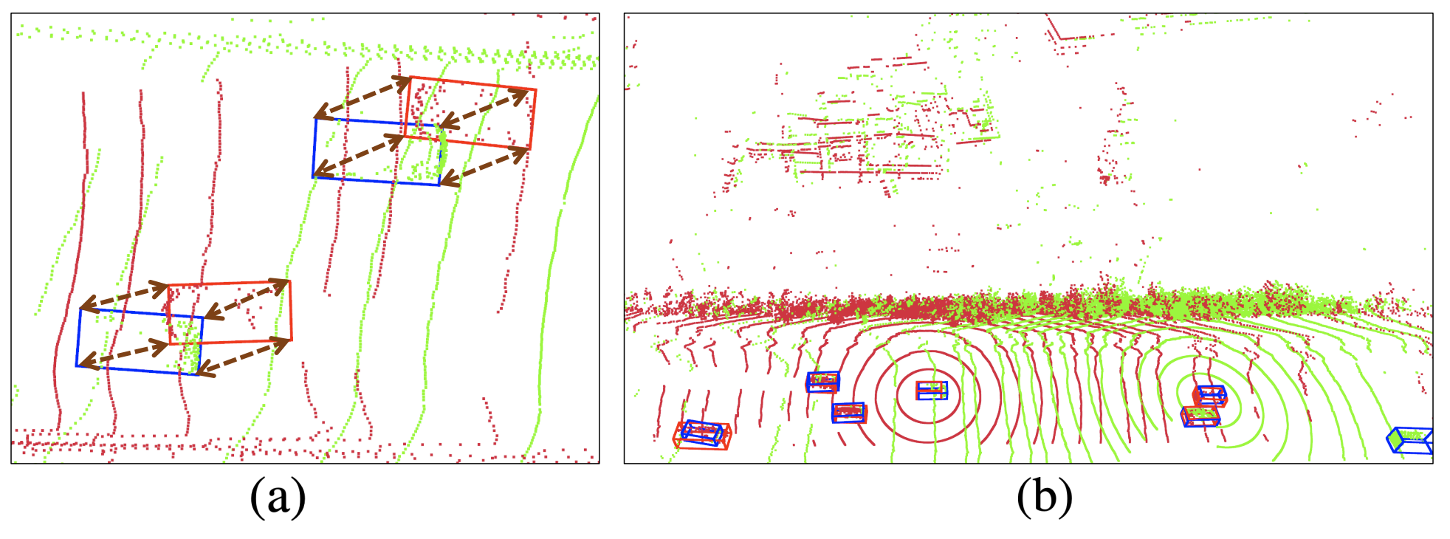
Stage 2: Object Bounding Box Alignment
Given the coarsely aligned images, we use the vertices of the detected objects (cars) as common observations for further alignment by running RANSAC again.

Slide 13


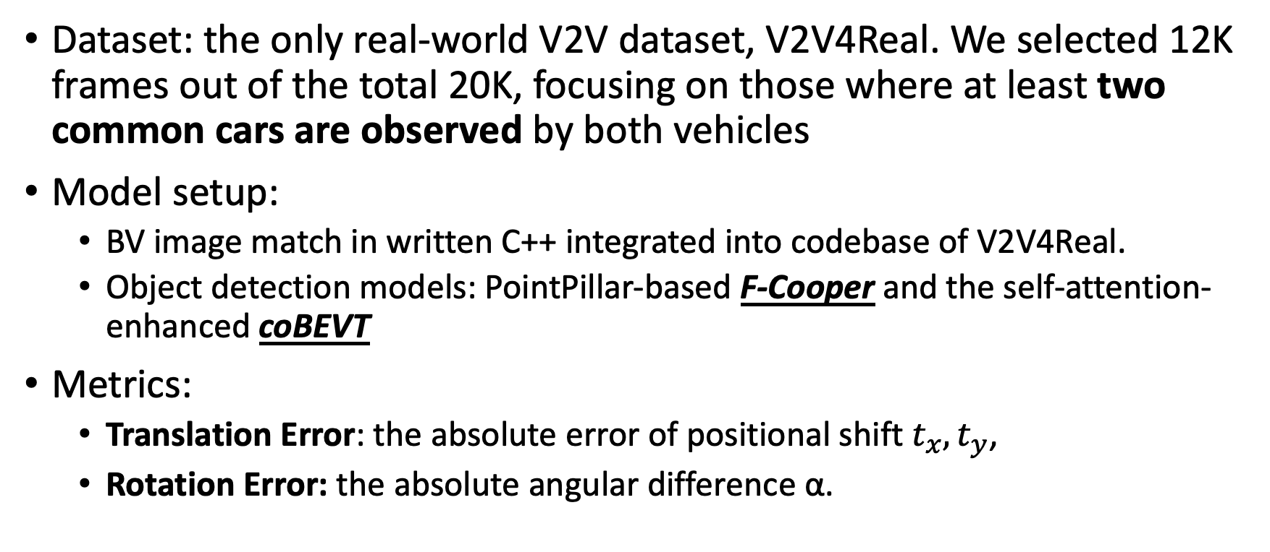
Performance Evaluation
Dataset: the only real-world V2V dataset, V2V4Real. We selected 12K frames out of the total 20K, focusing on those where at least two common cars are observed by both vehicles
Model setup:
BV image match in written C++ integrated into codebase of V2V4Real.
Object detection models: PointPillar-based F-Cooper and the self-attention-enhanced coBEVT
Metrics:
Translation Error: the absolute error of positional shift${ t}_{x},t_{y}$,
Rotation Error: the absolute angular difference α.

Slide 14
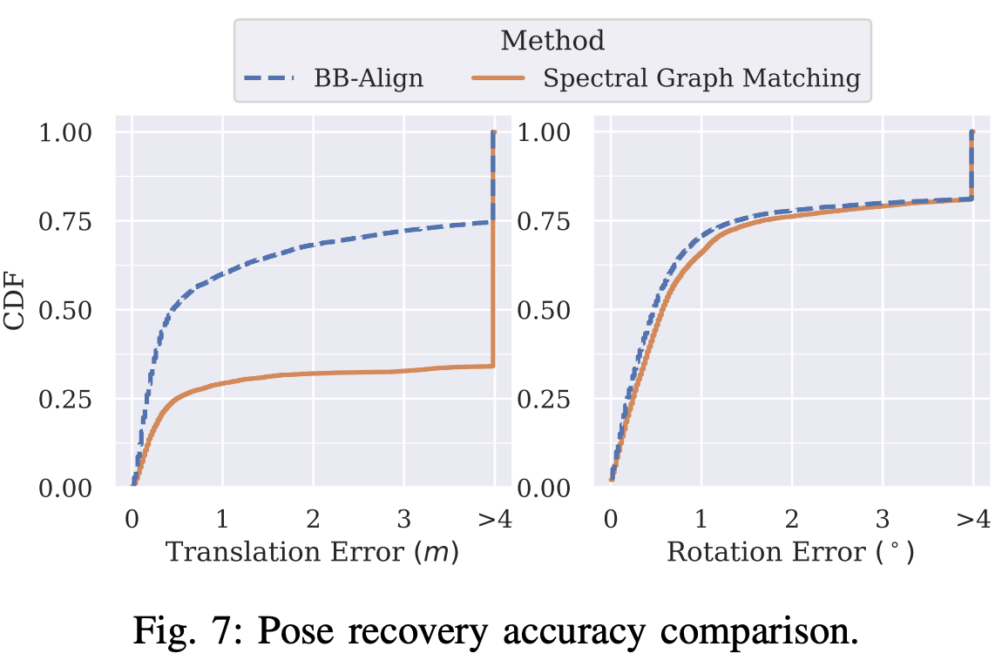
Accuracy Study
Compared to VIPS[1]: The only other non-training, plug-and-play method, which is based on graph matching.
62%
30%
S. Shi, J. Cui, Z. Jiang, Z. Yan, G. Xing, J. Niu, and Z. Ouyang, “Vips: real-time perception fusion for infrastructure-assisted autonomous driving,” in Proceedings of the 28th Annual International Conference on Mobile Computing And Networking, MobiCom ’22.

Slide 15
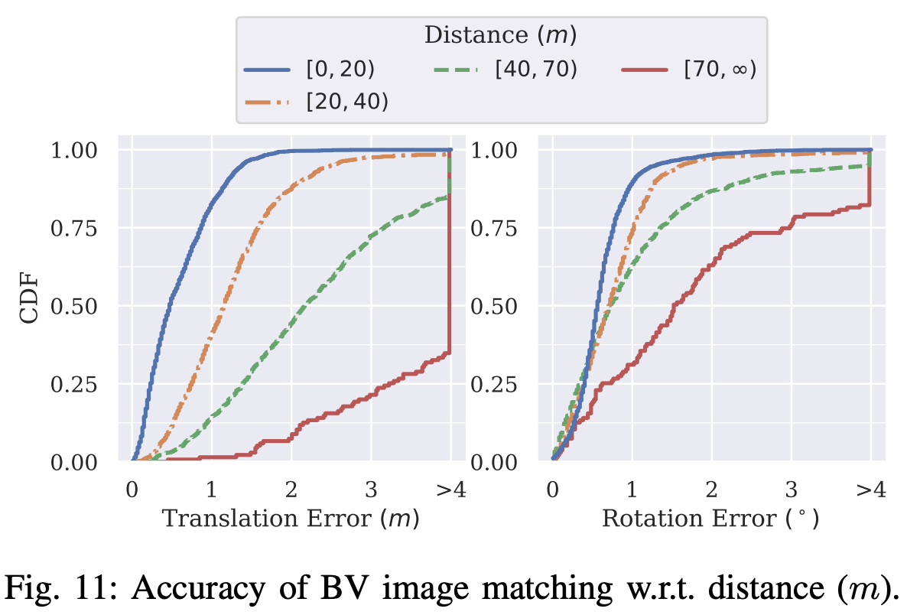
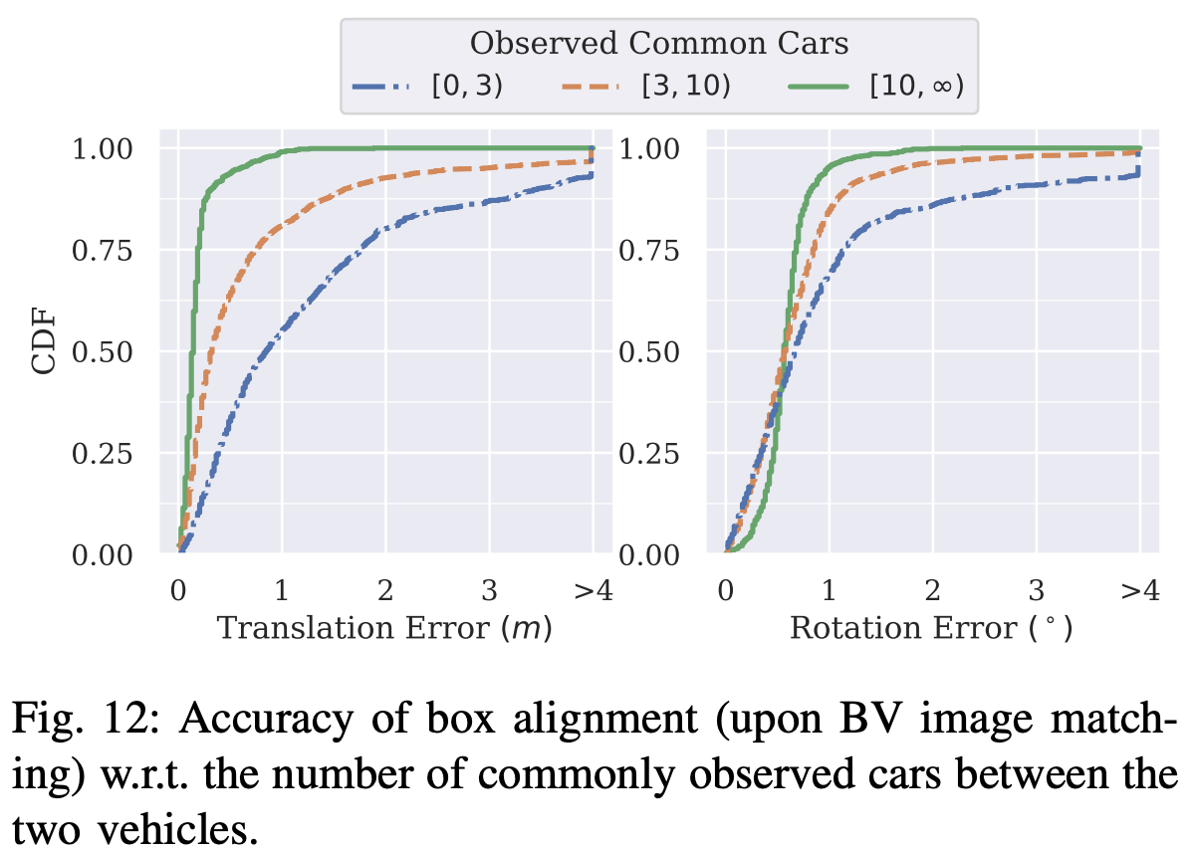
Performance Impact Factors
Stage 1 (BV Image Matching) is sensitive to distance. Stage 2(Box Alignment) is largely determined by co-visible cars.

Slide 16
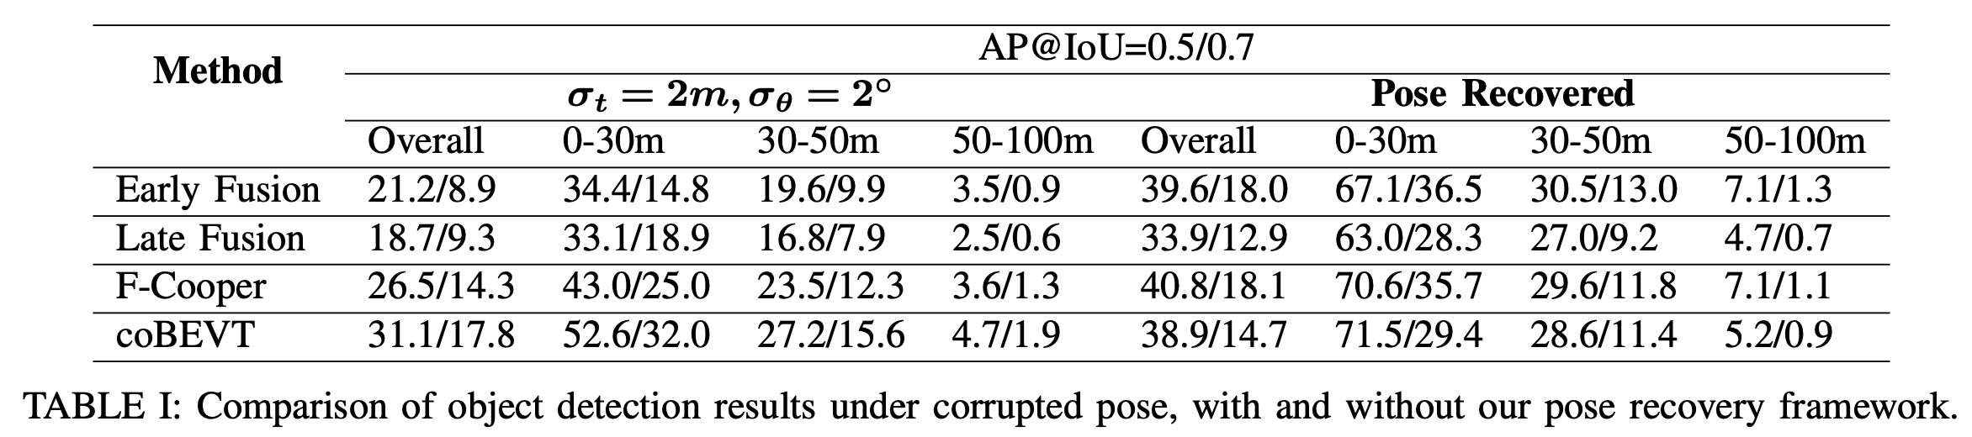
Objection Detection Improvement
We incorporate the proposed method into various fusion techniques and examine the differences compared to not using it.
The improvement is significant in all cases, with nearly a 2x gain in the early fusion case.
Notably, the improvement in the close-range scenarios (0-30m) is even more exciting, with AP@IoU=0.5 scores across all methods exceeding 60.0, and some reaching above 70.0.

Slide 17
Summary and Future Work
We introduce BB-Align, a lightweight, two-stage pose recovery framework tailored for V2V cooperative perception.
Utilizing Bird’s-eye View (BV) images and object bounding boxes, the framework accurately estimates the relative pose between two cars while minimizing communication costs.
Designed as a non-training-based, plug-and-play module, BB-Align integrates seamlessly with existing V2V systems.
Future work includes exploring enhancements in time efficiency.
Questions?
Lixing Song
song3@rose-hulman.edu

